Slide 1
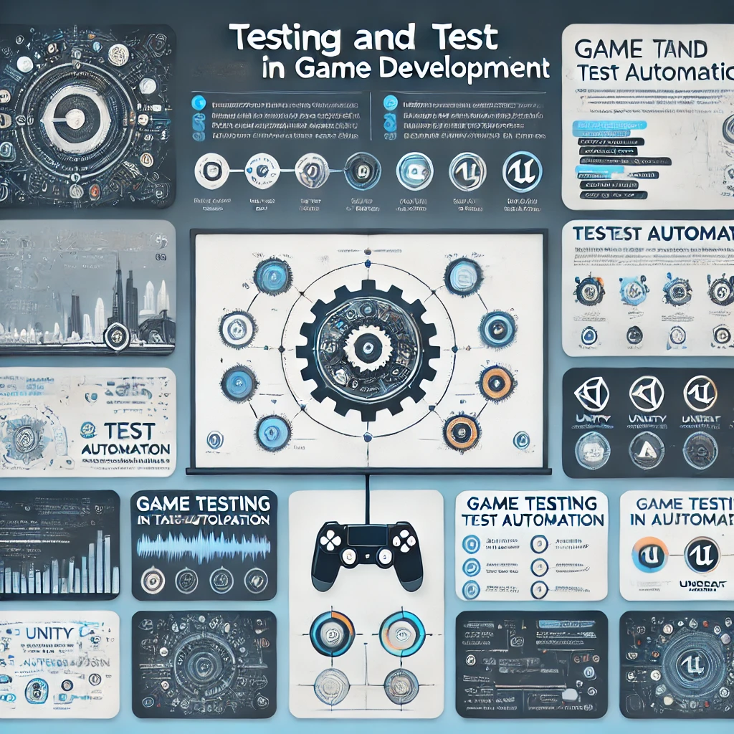
Testing and Test Automation in Game Development
Testing in Unity / Unreal

Slide 2
Agenda
Introduction to Game Testing and Test Automation
Testing in Unity and Unreal Engine
Setting up Test Automation Framework
Case Study: Tic Tac Toe Game Test Automation
Best Practices for Test Automation in Game Development
Conclusion
Demo: Test Automation in Unity
Q&A

Slide 3
Introduction to Game Testing
What is Game Testing ?
- It is the process of evaluating and verifying the functionality performance, and
quality of games.
- Testing ensures game is free of bugs and performs well across different
environments.
Why is Testing Important?
- Ensures a smooth gaming experience for players.
- Improves game quality by catching bugs early.
- Saves time and costs in the long run by automating repetitive tests.

Slide 4
Manual vs. Automated Game Testing
Manual Testing
Involves playing games and checking for bugs, performance issues, and gameplay inconsistencies.
Best for exploratory testing or when the game changes frequently.
Automated Testing
- Uses scripts and testing frameworks to automatically run tests on the game’s functionality.
- Saves time, reduces human error, and is ideal for repetitive tasks like regression testing.

Slide 5
Role of Test Automation in Game Development
What is Test Automation ?
Automating the execution of tests without manual intervention.
Reduces the time to detect issues and bugs.
Benefits of Test Automation in Game Development
Faster feedback on code changes
Continuous integration with automated tests.
Helps scale testing to cover complex and large game worlds.

Slide 6
Testing in Unity
Unity Testing Framework
Unity uses the Unity Test Framework based on NUnit.
Supports unit tests, integration tests, and automated tests for gameplay and functionality.
Types of Tests in Unity
Unit Tests: Test individual components of the game, such as game logic or character movement.
Integration Tests: Test the interaction between components (e.g., physics, animation).
UI Tests: Test the user interface for usability and correctness.

Slide 7
Testing in Unreal Engine
Unreal Engine Testing Framework
Unreal uses Unreal Automation System (UAT) for automated testing.
Supports unit tests, gameplay testing, and stress testing.
Types of Tests in Unreal
Unit Tests: Focus on logic and small code units.
Functional Tests: Check specific gameplay functions, like player input or game physics.
Performance Tests: Assess game performance under different conditions.

Slide 8
Setting Up Test Automation Framework for Unity
Prerequisites
Install Unity Test Framework via Unity Package Manager.
Set up NUnit for writing test scripts.
Writing Test Cases
Create a Test Script for game logic (e.g., Tic-Tac-Toe’s win condition check).
Use [Test] attributes to define test methods.
Example: Testing a Tic-Tac-Toe win condition (horizontal line).

Slide 9
Setting Up Test Automation Framework for Unreal
Unreal Test Framework Setup
Unreal Engine comes with built-in Automation System.
Test cases can be created using Automation Tool and Unreal’s scripting language.
Writing Test Cases
Create Functional Test Cases to check game behaviors.
Example: Testing player input and board updates in Tic-Tac-Toe

Slide 10
Case Study: Manual Testing for Tic Tac Toe
Manual Testing Process
Play through the Tic-Tac-Toe game and check all the game scenarios (win, draw, invalid moves).
Ensure no bugs in game logic, player input, or board rendering.
Observe edge cases (e.g., invalid move input or multiple moves in the same spot).
Challenges with Manual Testing
Time-consuming and repetitive.
Prone to human error.

Slide 11
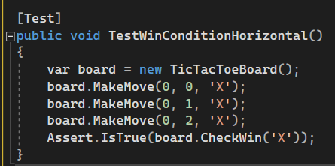
Case Study: Automated Testing for Tic Tac Toe in Unity
Automating Test Cases in Unity
Use Unity Test Framework to write automated test cases for Tic-Tac-Toe.
Example: Test for winning a condition (e.g., three ‘X’ in a row).
Benefits of Automation in this Case
Tests can be run repeatedly with quick feedback.
Easily covers all possible win conditions and edge cases.

Slide 12
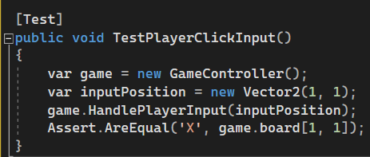
Testing Player Input in Unity
Test Automation for Player Input
Unity Input System can be tested by simulating key presses and mouse clicks during the test. Automated tests can check if the game reacts as expected (e.g., moves on the board in Tic-Tac-Toe).
Use Unity's Test Runner and Input Simulation for testing player-controlled actions.

Slide 13
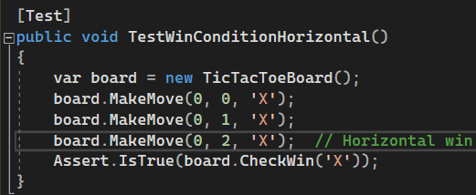
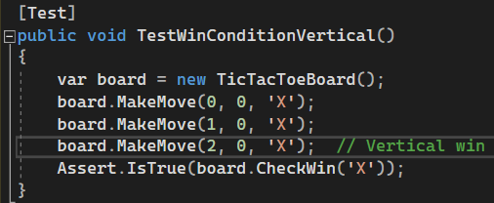
Unity Unit Test for Win Conditions
Unit Testing for Game Logic
- In Unity, testing critical game logic (e.g., win conditions) is straightforward with the Unity Test Framework.
- CheckWin is a key function to validate whether a player has won after a move. Automated tests help in ensuring the game behaves correctly for every possible move and outcome.

Slide 14
Unity Test Runner and Continuous Integration
Unity Test Runner
Unity Test Runner is a powerful tool that integrates unit tests, integration tests, and UI tests into the Unity Editor. It enables testing across platforms, from Windows to mobile devices.
The Test Runner helps run tests during game development to verify that no critical features break with each build.
Continuous Integration in Unity
Implementing CI/CD (Continuous Integration and Continuous Deployment) allows automated test execution every time the game code changes.
Platforms like Jenkins, GitLab CI, or GitHub Actions can be used to automate test execution.

Slide 15
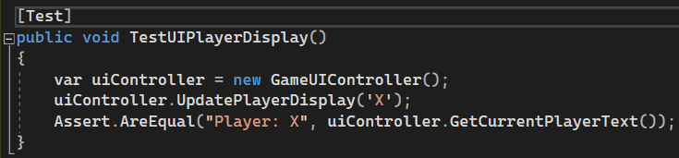
Automated Testing for Game (Unity)
Automating User Interface Testing
Unity provides tools to test UI elements like buttons, menus, and sliders. For Tic-Tac-Toe, this could include testing if the correct player is displayed after each move.
Unity Test Tools allows simulating user input to trigger UI events automatically.

Slide 16
Performance Testing in Unity
Testing Game Performance
Performance testing ensures that the game runs smoothly under various conditions.
Use Profiler in Unity to identify performance bottlenecks and optimize game flow.
Example
Run automated tests to simulate a Tic-Tac-Toe game and measure the frame rate to ensure consistent performance.

Slide 17
Best Practices for Unity Game Testing
Test Automation Best Practices
Run Tests Frequently: Integrate automated tests into the CI pipeline to catch issues early.
Focus on Critical Game Mechanics: Prioritize tests for game-breaking issues such as input handling, win conditions, and AI behavior.
Ensure Cross-Platform Compatibility: Test the game on different platforms (PC, mobile, consoles) to ensure compatibility.

Slide 18
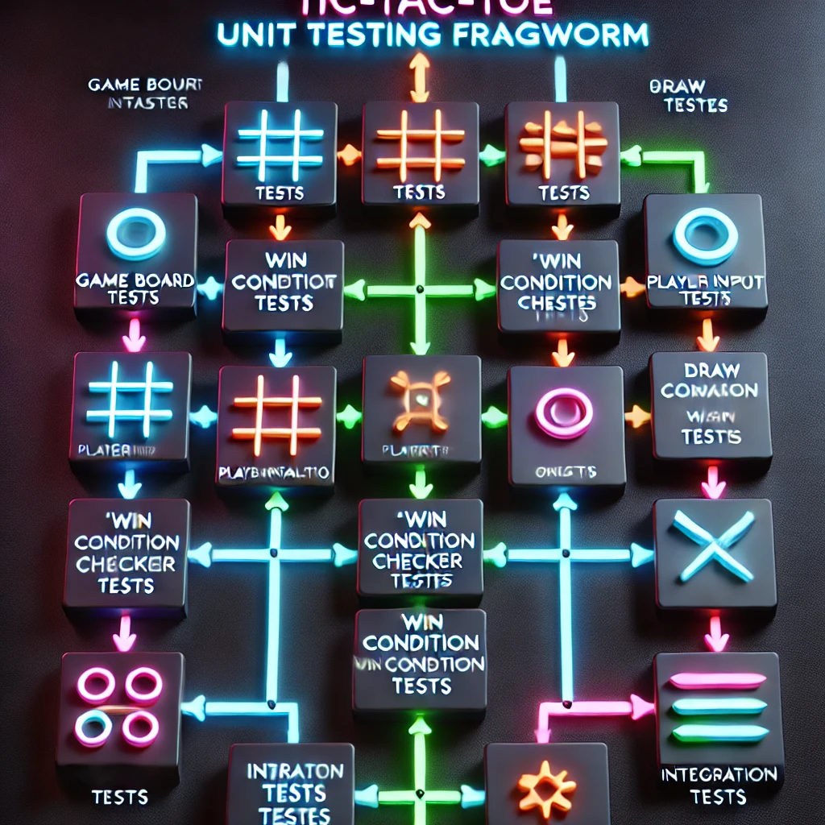
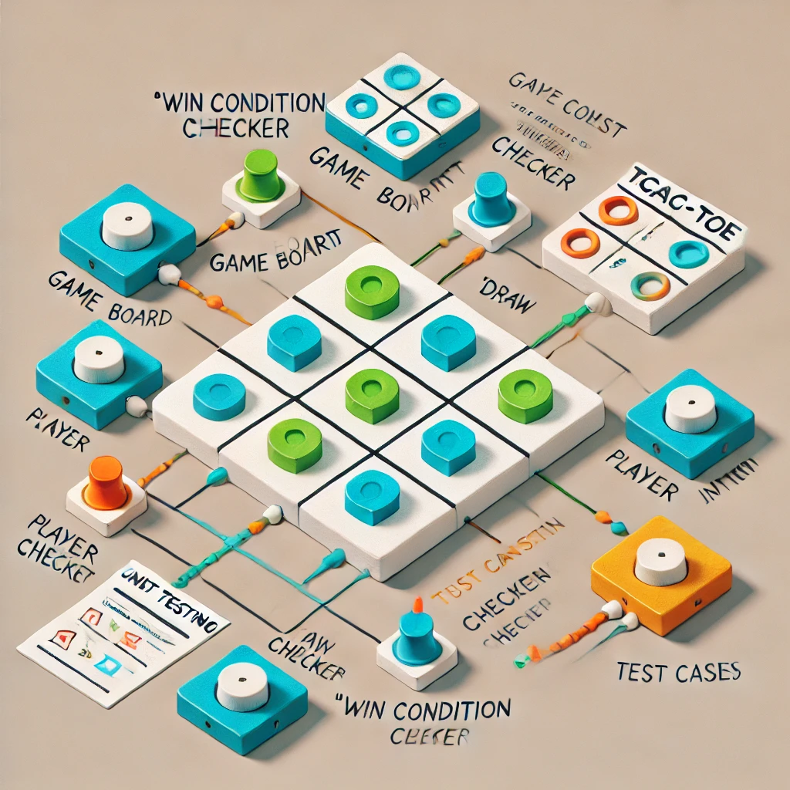
Unity Testing Framework
Tic Tac Toe Game

Slide 19
Tic - Tac - Toe Unit Testing Framework
|
├── Game Board Tests
| ├── Test Initialization(empty 3x3 grid)
| ├── Test Player Move Placement
| ├── Test Invalid Moves(out - of - bound or occupied cell)
| └── Test Board Reset
|
├── Player Input Tests
| ├── Test Input Validation
| ├── Test Turn Alternation
| └── Test Player Assignment(X or O)
|
├── Win Condition Checker Tests
| ├── Test Row Win Condition
| ├── Test Column Win Condition
| ├── Test Diagonal Win Condition
| └── Test No - Win Scenarios
|
├── Draw Condition Checker Tests
| ├── Test Full Board with No Winner
| └── Test Partial Board(not a draw)
|
└── Integration Tests
├── Test Full Game Flow(Player X wins)
├── Test Full Game Flow(Player O wins)
└── Test Game Ends in a Draw

Slide 20
Conclusion
Recap
Game testing is vital to ensuring the quality and stability of a game before release.
Unity and Unreal offer robust frameworks to automate game testing, saving time and increasing reliability.
Automated tests help with regression, performance, and overall testing, making sure the game is ready for players.

Slide 21
Any Questions ?

